Slide 1


SRI RAMAKRISHNA INSTITUTE OF TECHNOLOGY
(An Autonomous Institution)
Pachapalayam, Perur Chettipalayam, Coimbatore- 641 010
DEPARTMENT OF COMPUTER SCIENCE AND ENGINEERING
20CS902-FYP Phase I Second Review
BATCH NO :39
ADDRESSING THE INCOME GAP CAUSED BY MIDDLEMEN IN AGRICULTURAL MARKETING THROUGH DIRECT FARMER-TO-CONSUMER SOLUTIONS
Presented by:
SOORAJ R NAIR - 71382202152
VIGNESHWARAN S - 71382202173
SARUKESH A - 71382202134
SANJAY S - 71382202130
Guided by:
MS A JAYASMRUTHI
Assistant Professor
Department of CSE

Slide 2
CONTENT OUTLINE
  Objectives
  Progress Overview
  Challenges and Solution
  Updated Methodology
  System Updates
  Implementation Updates
  Result and Analysis
  Evaluation Metrics
  Conclusion
  References

Slide 3
OBJECTIVES
The Farmer income and profitability which will lead to they income , marketing farming a more sustainable and profitable livelihood.
They provide consumers with access to fresh , Quality produce that will ensures that consumer received fresher , higher quality produce that retains its nutritional value ,taste and appearance.
Empower farmer with direct market access that will reduces their dependency on local traders and empowers them to make informed decision about their crop production and pricing.

Slide 4
PROGRESS OVERVIEW
Efforts to connect farmers directly to consumers have grown, helping farmers earn more by cutting out middlemen.
Technologies like e-commerce platforms, mobile apps, and farmers' markets allow farmers to sell directly to buyers, increasing their profits by 15-40% in some cases.
Digital tools like online marketplaces and social media help farmers reach more customers, share product details, and build trust

Slide 5
CHALLENGES AND SOLUTIONS
Market Information Gaps: Farmers often don’t know current market prices or consumer preferences, which limits their ability to make smart selling decisions.
Middlemen Dominance: Middlemen control much of the supply chain, offering low prices to farmers while charging high prices to consumers.
Provide Market Information: Use radio, TV, or apps to share real-time price and demand data, helping farmers make informed choices.
Use Digital Payments: Promote platforms like UPI or Paytm for instant payments, reducing dependency on middlemen and ensuring fair prices.

Slide 6
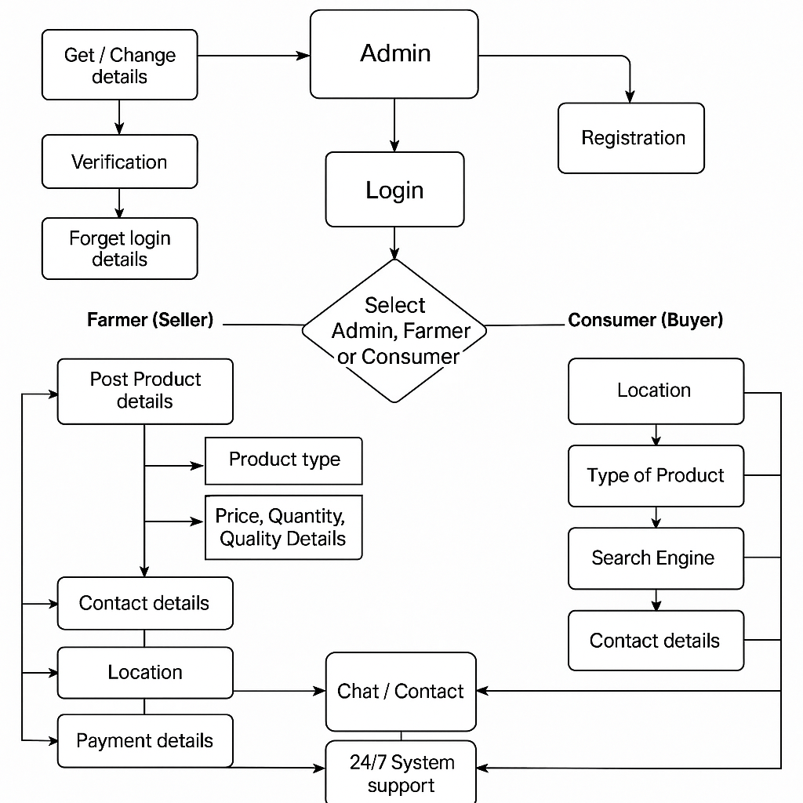
UPDATED METHODOLOGY

Slide 7
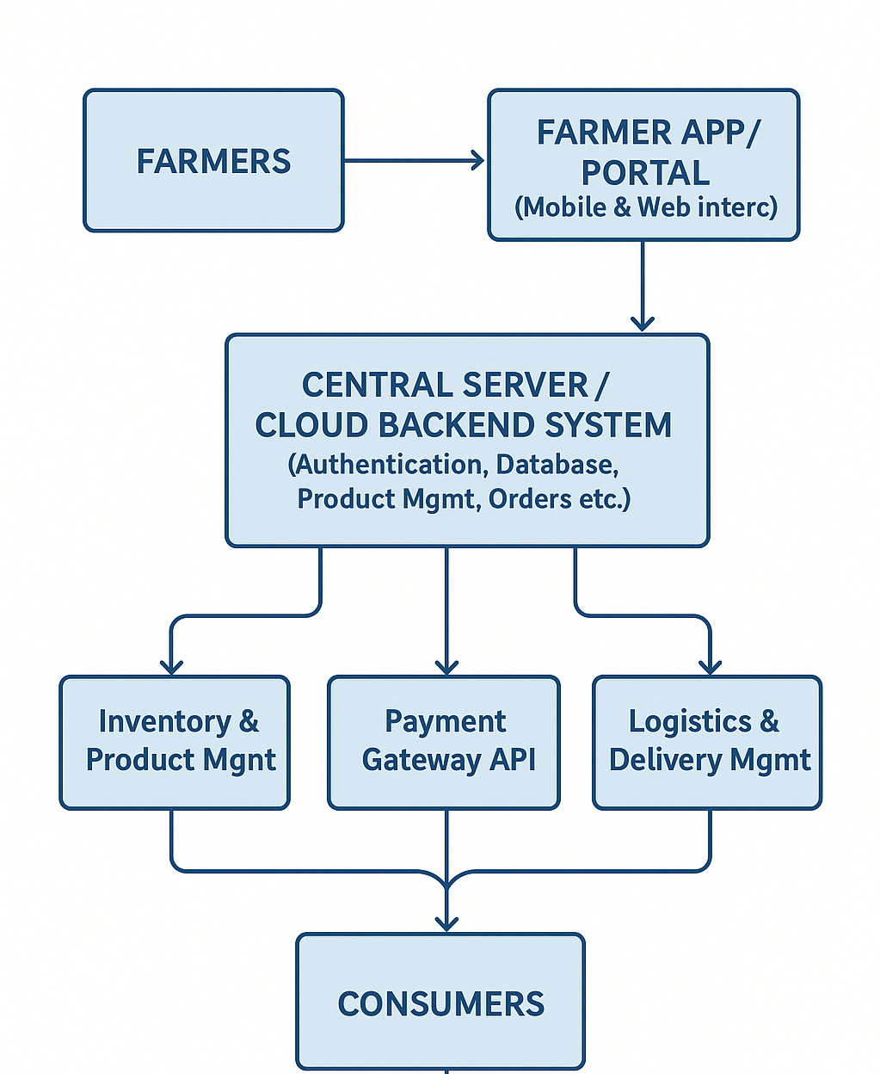
SYSTEM UPDATES

Slide 8
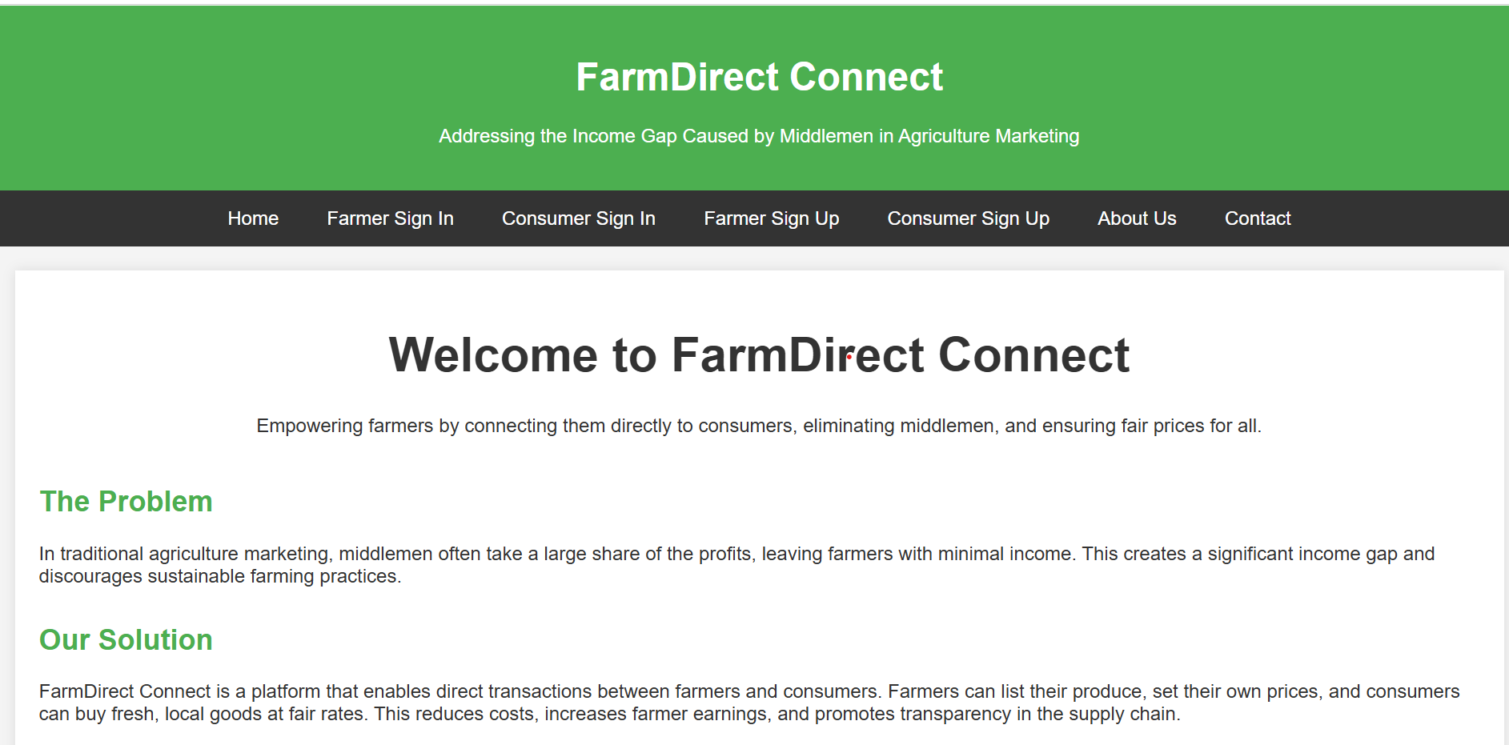
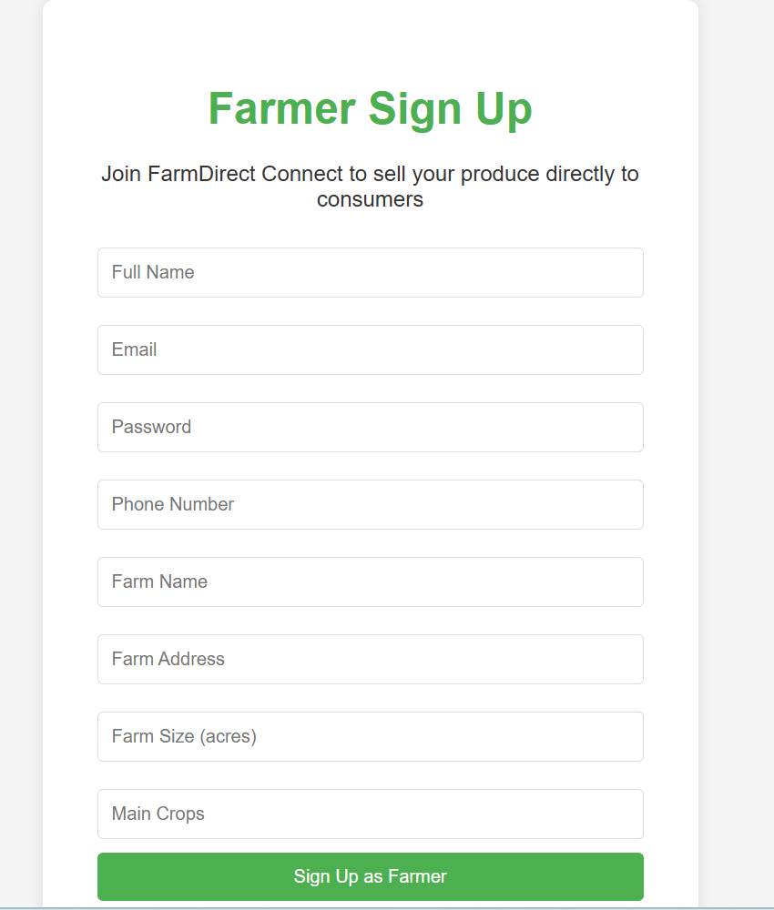
Implementation Updates

Slide 9
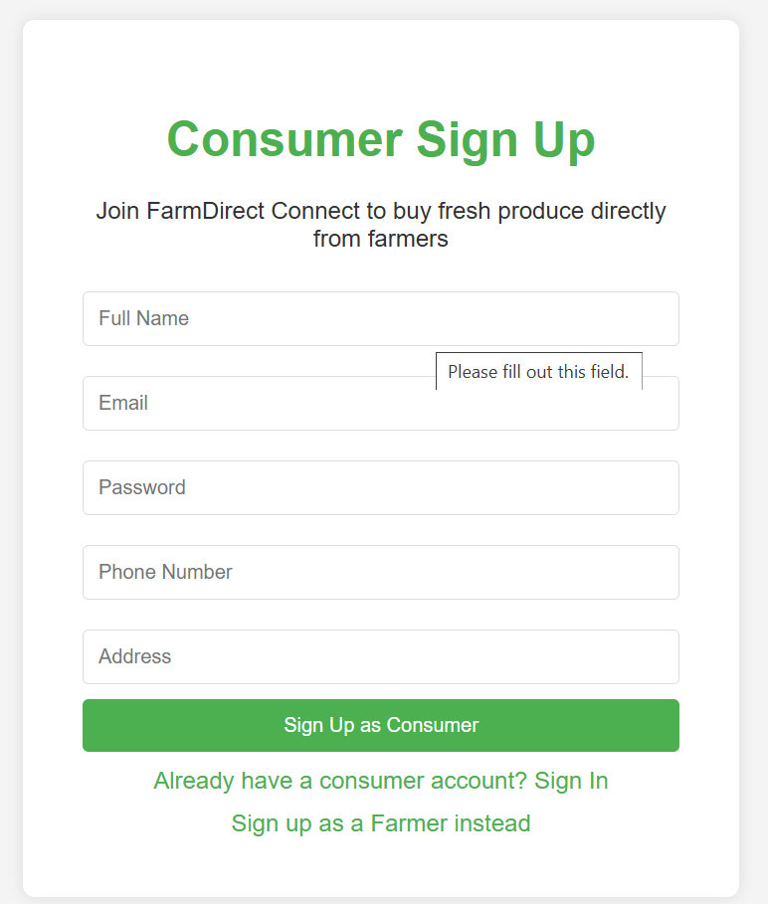
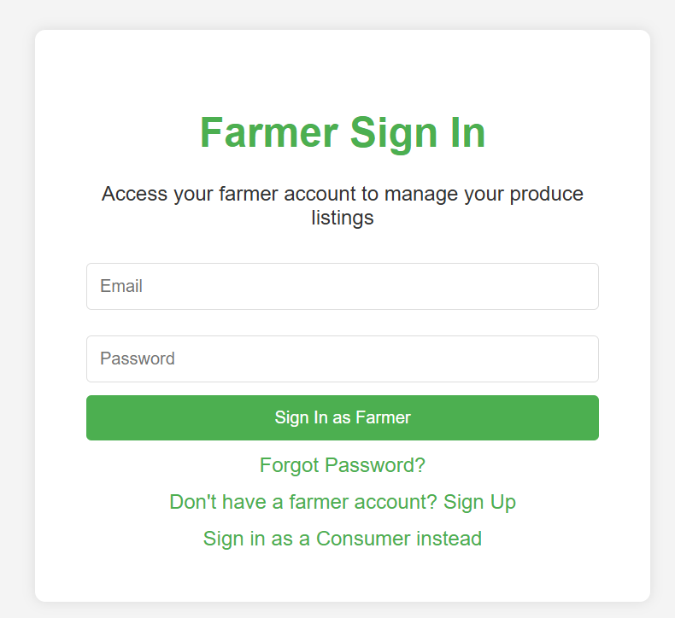
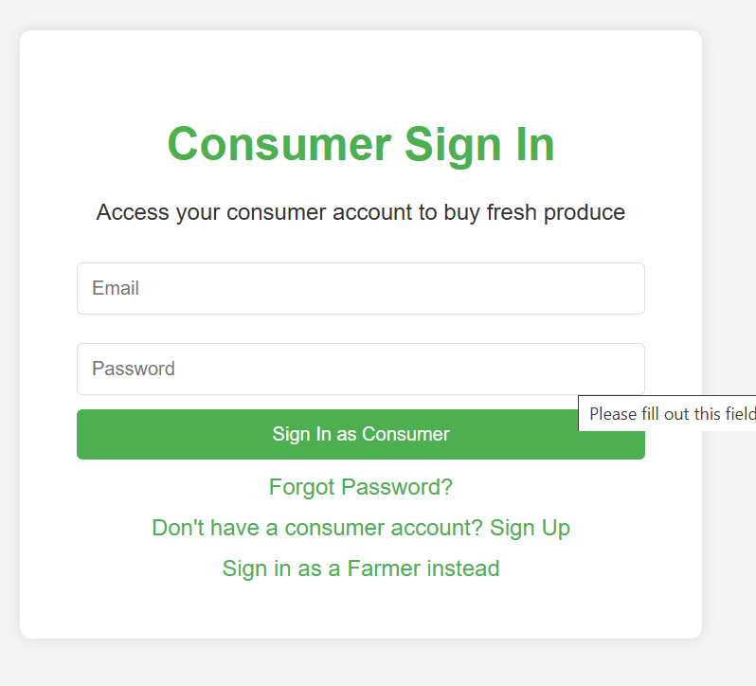
Implementation Updates

Slide 10
Results and Analaysis
Farmers using direct marketing (e.g., farmers' markets, CSAs) reported 10-30% higher net incomes compared to traditional channels, due to captured retail margins.
Rural e-commerce increased household income by 15-25% and reduced intra-rural income disparities by promoting part-time opportunities for vulnerable groups.
F2C models effectively address the income gap by empowering farmers to capture a larger share of the value chain—often 30-50% more than traditional middlemen-driven systems.
Overall, F2C models are promising for sustainable agriculture, promoting economic equity and environmental benefits through localized supply chains.

Slide 11
Evaluation Metrics
Income Increase Percentage
Profit Margin per Unit
Cost Reduction from Middlemen
Sales Volume Growth
Delivery Success Rate
Post-Harvest Loss Reduction

Slide 12
CONCLUSION
    Middlemen significantly reduce farmer profits by capturing a large portion of the consumer price, creating an income gap in traditional agricultural marketing.
    Direct-to-consumer (D2C) web-based solutions offer a practical way to bridge this gap, enabling farmers to sell directly, increase their earnings, and build better customer relationships.
    By using simple digital tools—such as websites, mobile apps, and online payment systems—small and local farmers can access wider markets without relying on intermediaries.
    The project demonstrates that a well-designed platform can improve farmer income by 10–30%, while providing consumers with fresher, more affordable produce.

Slide 13
REFERENCES
D. S. V. Gowd, N. V. R. Reddy and K. Aravind, “Farmer To Consumer,” Conference Paper, Parul University, Mar. 2025.
P. Kushwaha, S. Mansoori, M. Patil, and R. Baheti “Transforming Agriculture: Enhancing Farmer-to-Consumer Connectivity Through Smart E-Commerce Platforms” Int. J. Sci. Res. Eng. Manag., vol. 9, no. 4, pp. 1–2, Apr. 2025.
A. S., A. S. V., M. M., and A. Jeyamurugan, “Web Based Application for Direct Market Access for Farmers,” Int. J. Creates. Thoughts, vol. 13, no. 4, pp. 192–197, Apr. 2025.
N. Anusha, P. S. Keerthi, M. R. Reddy, A. Ramesh, and M. R. Ignatious, “Farm to Home: An E-commerce Application for Farmers and Consumers,” in Advances in Computational Intelligence and its Applications, May 2024. DOI: 10.1201/9781003488682-5.
S. Uplaonkar and S. Biradar, “Middleman Growth in Agricultural Field and Its Impact on Farmers,” Int. J. Creat. Res. Thoughts, vol. 8, no. 3, pp. 3314–3317, Mar. 2020.

Slide 14
        THANK YOU

